Slide 1
Zero-Downtime deployments with Kubernetes
Mateusz Dymiński
Nokia

Slide 2
Whoami
Mateusz Dymiński
Software Developer at Nokia
8+ exp with Java
4+ exp with Go
One of the organizer GoWroc - Golang Wroclaw Meetup
Github: github.com/mateuszdyminski
Twitter: @m_dyminski
LinkedIn: linkedin.com/in/mdyminski

Slide 3
Agenda
Zero Downtime Deployment
Kubernetes
Demo Application
Graceful Shutdown
Deployments demo
Summary

Slide 4
github.com/mateuszdyminski/zero

Slide 5


Slide 6

apki u

Slide 7


Slide 8
What is this zero downtime deployment?
Deploy application to production
End user can’t notice any errors/problems during the deployment
Monitoring tools shouldn’t even notice that deployment is ongoing/done
Bugs can be fixed without any outage.
New features can be introduced without any outage.
Required for Continuous Delivery - CD

Slide 9
Zero downtime deployment types
Rolling Updates deployment
Blue/Green deployment
Canary deployment

Slide 10
Rolling Update Deployment
Rolling Update deployment is when you run new version of the application next to the old one
Have proxy or load balancer in front of your applications
One by one new application is deployed and old one is shutdown
Problem – client needs handle old and new application in the same time

Slide 11

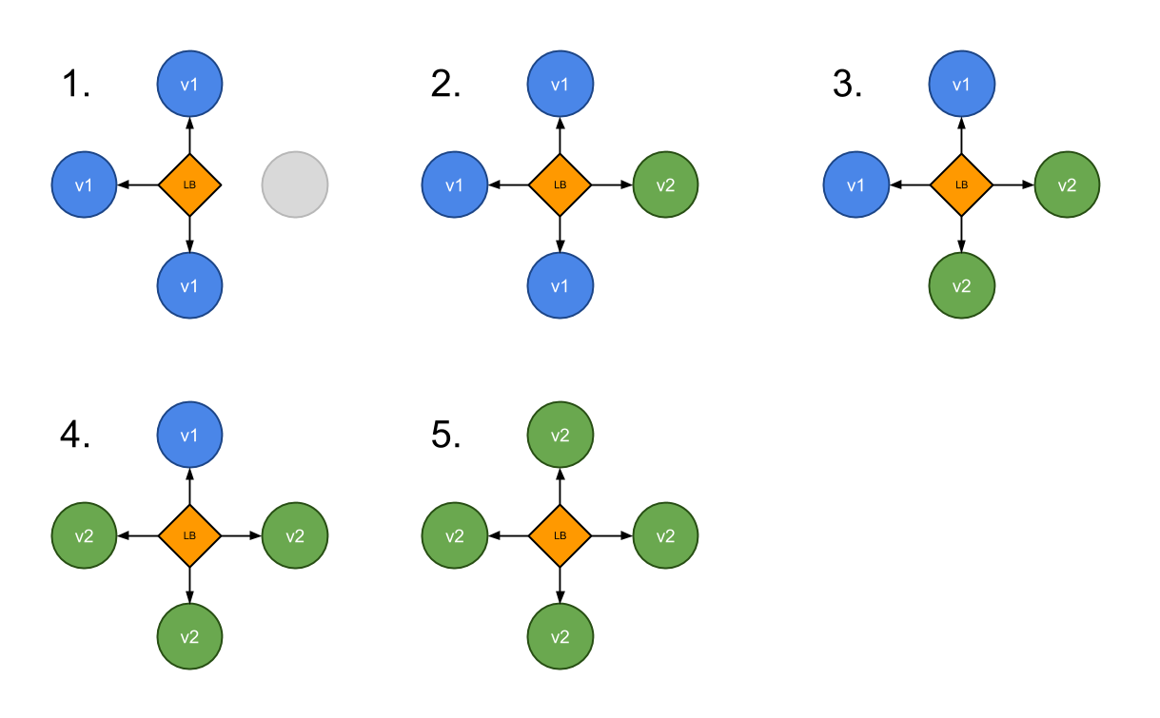
Rolling Update Deployment

Slide 12
Blue Green Deployment
A blue-green deployment is when you run two complete deployments of your application.
A deployment that is currently in production, and a deployment with the changes you want to introduce.
Have proxy or load balancer in front of your applications
Switch traffic to the new deployment when you are ready to take your changes into production.

Slide 13
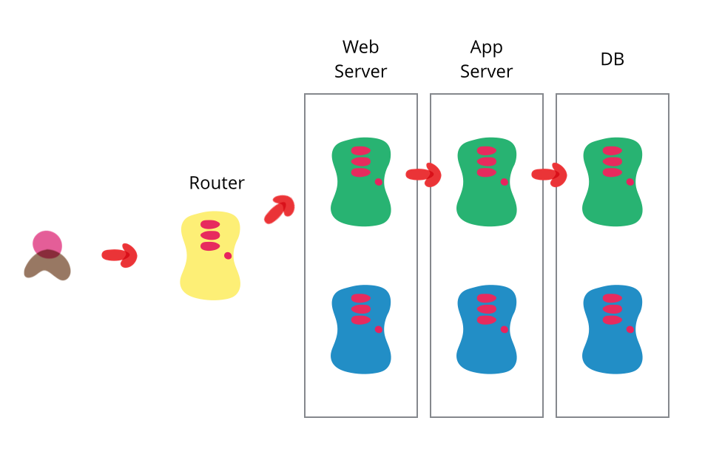
Blue Green Deployment
Source: https://martinfowler.com/bliki/BlueGreenDeployment.html

Slide 14
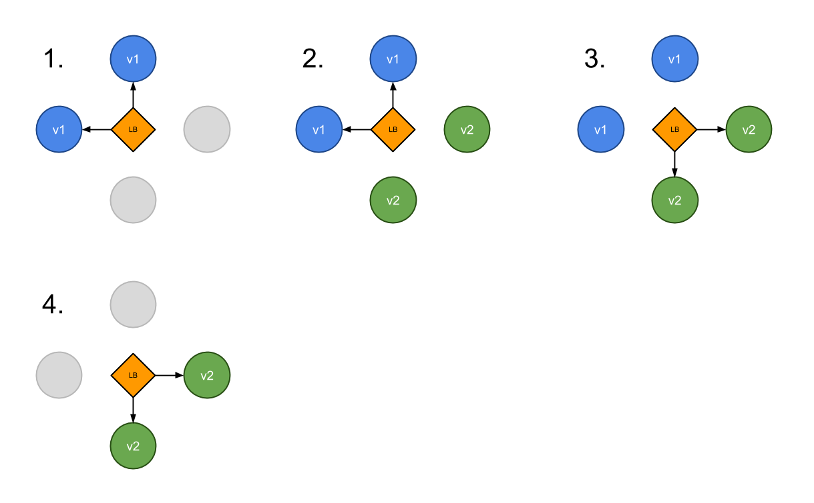
Blue Green Deployment

Slide 15
Canary Deployment
Canary deployment is when you run new version of the application next to the old one
Have proxy or load balancer in front of your applications
Some new applications are deployed next to the old ones
Part of the traffic is moved to the new application based on some rules – random, weight, cookie, http header etc.
Problem – client needs handle old and new application in the same time

Slide 16
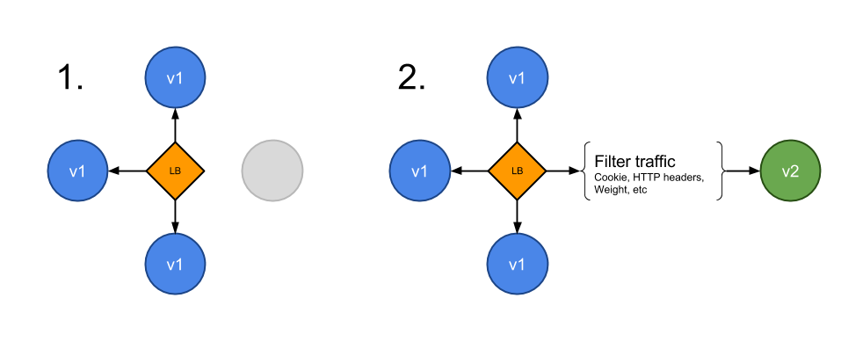
Canary Deployment

Slide 17
Who of you hears about Kubernetes?
Who of you play with Kubernetes?
Who of you is using Kubernetes on production?

Slide 18

Kubernetes

Slide 19
Kubernetes
Open source platform that automates Linux container operations.
Eliminates many of the manual processes involved in deploying and scaling containerized applications.
Groups hosts running Linux containers
Kubernetes helps you easily and efficiently manage those clusters.
These clusters can span hosts across public, private, or hybrid clouds

Slide 20
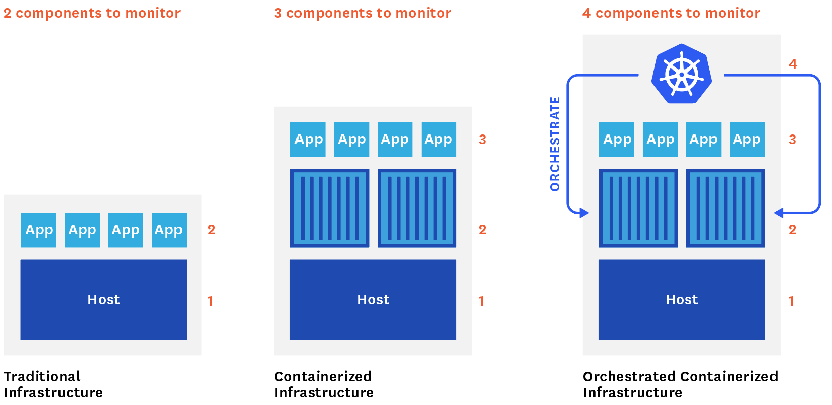

Slide 21
Why Kubernetes
Orchestrate containers across multiple hosts.
Make better use of hardware to maximize resources needed to run your enterprise apps.
Control and automate application deployments and updates.
Mount and add storage to run stateful apps.
Scale containerized applications and their resources on the fly.
Declaratively manage services, which guarantees the deployed applications are always running how you deployed them.
Health-check and self-heal your apps with autoplacement, autorestart, autoreplication, and autoscaling.

Slide 22
Demo

Slide 23
Demo Application

Slide 24
Demo Application
Users Service
REST API
Storage: MySQL

Slide 25
User
type User struct {
ID int `json:"id"`
FirstName string `json:"firstName"`
SecondName string `json:"secondName"`
BirthDate time.Time `json:"birthDate"`
}

Slide 26
Server + API
router := mux.NewRouter()
rest, err := NewUserRest(buildInfo(), dbInfo())
if err != nil {
log.Fatal(err)
}
router.HandleFunc("/api/users", rest.Users).Methods("GET")
router.HandleFunc("/api/users", rest.AddUser).Methods("POST")
router.HandleFunc("/api/users/{id}", rest.GetUser).Methods("GET")
router.HandleFunc("/health", rest.Health).Methods("GET")
router.HandleFunc("/api/error", rest.Err).Methods("POST")
router.Handle("/metrics", promhttp.HandlerFor(
prometheus.DefaultGatherer,
promhttp.HandlerOpts{},
))
log.Fatal(http.ListenAndServe(":"+*port, NewLogginHandler(router)))

Slide 27
REST
func (r *UserRest) Users(w http.ResponseWriter, req *http.Request) {
rows, err := r.db.Query("SELECT * FROM users")
if err != nil {
WriteErr(w, err, http.StatusInternalServerError)
return
}
users := make([]User, 0, 0)
for rows.Next() {
var uid int
var firstName, secondName string
var birthDate time.Time
err = rows.Scan(&uid, &firstName, &secondName, &birthDate)
if err != nil {
WriteErr(w, err, http.StatusInternalServerError)
return
} users = append(users, User{ID: uid, FirstName: firstName, SecondName: secondName, BirthDate: birthDate})
}
if rows.Err() != nil {
WriteErr(w, rows.Err(), http.StatusInternalServerError)
return
}
WriteJSON(w, users)
}

Slide 28
Demo Users Service
Run
Open
$ go run main.go --db-pass=password --db-host=192.168.99.101:31125
http://localhost:8080/api/users

Slide 29
Users Service on Kubernetes
Service file:
apiVersion: v1
kind: Service
metadata:
name: users-go-api
spec:
type: NodePort
ports:
- port: 8080
nodePort: 31001
selector:
app: users-go-api

Slide 30
Users Service on Kubernetes
Deployment file:
apiVersion: extensions/v1beta1
kind: Deployment
metadata:
name: users-go-api-deployment
spec:
replicas: 1
template:
metadata:
labels:
app: users-go-api
spec:
containers:
- name: users-go-api
image: index.docker.io/mateuszdyminski/zero-golang:v1
ports:
- containerPort: 8080

Slide 31
Demo Users Service on Kubernetes
Create MySQL
Create service
Create Deployment
Open
$ helm install --name mysql stable/mysql
$ kubectl get service mysql-mysql -o yaml | sed 's/type: ClusterIP/type: NodePort/g' | kubectl replace -f -
$ cd mysql && ./mysql.sh create
$ kubectl apply –f 01_users_srv.yaml
$ kubectl apply –f 02_deployment.yaml
http://192.168.99.101:31001/api/users

Slide 32
Rolling update deployment

Slide 33
Rolling Update Deployment
Deployment file:
apiVersion: extensions/v1beta1
kind: Deployment
metadata:
name: users-go-api-deployment
spec:
replicas: 2
strategy:
type: RollingUpdate
rollingUpdate:
maxUnavailable: 0
maxSurge: 1
template:
metadata:
labels:
app: users-go-api
spec:
containers:
- name: users-go-api
image: index.docker.io/mateuszdyminski/zero-golang:v1
ports:
- containerPort: 8080
Rolling Update

Slide 34
maxUnavailable and maxSurge
maxUnavailable:
The number of pods that may be unavailable during the deployment. This is relative to the desired number, specified in replicas.
It can be either an absolute number or a percentage.
It should obviously be lower than the number of replicas, or no pods may remain available during the update.
maxSurge:
The (additional) number of pods that can be created, on top of the desired number of replicas.
This too can be either an absolute number or a percentage.
A higher number may speed up the deployment, but will also require more system resources.

Slide 35
Rolling update deployment
Deploy new version of our Application:
To check if it’s Zero-Downtime:
$ kubectl set image deployments/users-go-api-deployment users-go-api=mateuszdyminski/zero-golang:v2
$ wrk -c 10 -d 30s http://192.168.99.101:31001/api/users/1 &
$ sleep 1 &&
$ kubectl set image deployments/users-go-api-deployment users-go-api=mateuszdyminski/zero-golang:v2

Slide 36
Graceful Shutdown

Slide 37
Graceful Shutdown
We can speak about the graceful shutdown of our application, when all of the resources it used and all of the traffic and/or data processing what it handled are closed and released properly.
It means that no database connection remains open and no ongoing request fails because we stop our application.

Slide 38
Scenario for a graceful web server shutdown
App gets notification to stop (received SIGTERM)
App lets know the load balancer that it’s not ready for newer requests
App served all the ongoing requests
App releases all of the resources correctly: DB, queue, etc.
App exits with "success" status code - usually ”0” - zero

Slide 39
Graceful Shutdown with Kubernetes
App receives SIGTERM signal because Kubernetes wants to stop it
App (pod) starts to return 500 for GET /health to let readinessProbe(Service) know that it's not ready to receive more requests.
Kubernetes readinessProbe checks GET /health and it stops redirecting traffic to the app (because it continuously returns 500)
App waits before it starts to shutdown - to make sure that the Service is getting notified via readinessProbe fail
App starts graceful shutdown
App first closes server with live working DB connections
App exits process
Kubernetes force kills the application after 30s (SIGKILL) if it's still running (in an optimal case it doesn't happen)

Slide 40
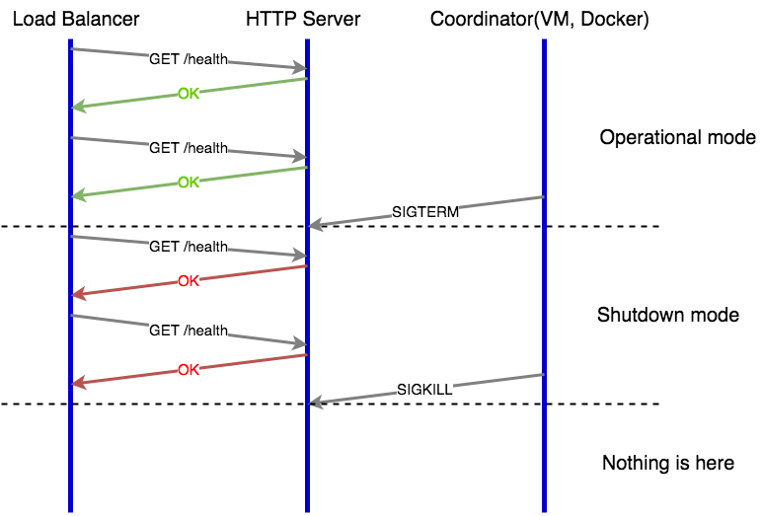
Web Server Graceful Shutdown

Slide 41
Graceful shutdown with Golang
Instead of:
We need to use:
log.Fatal(http.ListenAndServe(":"+*port, golang.NewLogginHandler(router)))
// create and start http server in new goroutine
srv := &http.Server{Addr: ":" + *port, Handler: golang.NewLogginHandler(router)}
go func() {
// we can't use log.Fatal here!
if err := srv.ListenAndServe(); err != nil {
log.Printf("http server stoped: %s\n", err)
}
}()

Slide 42
Graceful shutdown with Golang
// subscribe to SIGTERM signals
quit := make(chan os.Signal)
signal.Notify(quit, os.Interrupt, syscall.SIGTERM)
// blocks the execution until os.Interrupt or syscall.SIGTERM signal appears
<-quit
log.Println("shutting down server. waiting to drain the ongoing requests...")
rest.Unhealthy()
// add extra time to prevent new requests be routed to our service
time.Sleep(5 * time.Second)
// shut down gracefully, but wait no longer than the Timeout value (default 20s).
ctx, cancelF := context.WithTimeout(context.Background(), Timeout*time.Second)
defer cancelF()
// shutdown the http server
if err := srv.Shutdown(ctx); err != nil {
log.Printf("error while shutdown http server: %v\n", err)
}
log.Println("server gracefully stopped")

Slide 43
Graceful shutdown with Golang
In REST Controller:
// Unhealthy sets server health to false - used in gracefull shutdown mode
func (r *UserRest) Unhealthy() {
r.mu.Lock()
defer r.mu.Unlock()
r.healthy = false
}
// Health handler is responsible for serving resonse with current health status of service.
func (r *UserRest) Health(w http.ResponseWriter, req *http.Request) {
r.mu.Lock()
defer r.mu.Unlock()
if r.healthy {
resp := HealthStatus{
Hostname: r.hostname,
StartedAt: r.startedAt.Format("2006-01-02_15:04:05"),
Uptime: time.Now().UTC().Sub(r.startedAt).String(),
Build: r.buildInfo,
}
WriteJSON(w, resp)
} else {
WriteErr(w, fmt.Errorf("Server in graceful shutdown mode"), http.StatusInternalServerError)
}
}

Slide 44
Rolling update deployment – Final Test
Final Test
$ wrk -c 10 -d 30s http://192.168.99.101:31001/api/users/1 &
$ sleep 1 &&
$ kubectl set image deployments/users-go-api-deployment users-go-api=mateuszdyminski/zero-golang:v3

Slide 45
Rolling update deployment – Final Test 2
Final Test
$ hey -disable-keepalive -c 10 -n 20000 http://192.168.99.101:31001/api/users/1 &
$ sleep 1 &&
$ kubectl set image deployments/users-go-api-deployment users-go-api=mateuszdyminski/zero-golang:v3

Slide 46
Blue Green Deployment

Slide 47
Blue Green Deployment

Slide 48
Users Service on Kubernetes
Service file:
apiVersion: v1
kind: Service
metadata:
name: users-go-api-bg
labels:
app: users-go-api
spec:
type: NodePort
ports:
- port: 8080
nodePort: 30002
selector:
app: users-go-api-blue
blue

Slide 49
Users Service on Kubernetes
Deployment file:
apiVersion: extensions/v1beta1
kind: Deployment
metadata:
name: users-go-api-deployment-bg
spec:
replicas: 1
template:
metadata:
labels:
app: users-go-api-blue
spec:
containers:
- name: users-go-api-blue
image: index.docker.io/mateuszdyminski/zero-golang:v1
ports:
- containerPort: 8080
blue

Slide 50
Blue Deployment
Create service
Create Deployment
Open
$ kubectl apply –f 04_bg_srv.yaml
$ kubectl apply –f 05_blue_deployment.yaml
http://192.168.99.101:31002/api/users

Slide 51
Blue Green Deployment

Slide 52
Green Deployment
Create service
Create Deployment
Open
$ kubectl apply –f 07_green_srv.yaml
$ kubectl apply –f 06_green_deployment.yaml
http://192.168.99.101:31003/api/users

Slide 53
Blue Green Deployment

Slide 54
Switch Environments from Blue to Green
Apply following changes into out main Service:
Then
apiVersion: v1
kind: Service
metadata:
name: users-go-api-bg
labels:
app: users-go-api
spec:
type: NodePort
ports:
- port: 8080
selector:
app: users-go-api-green
blue -> green
$ kubectl apply –f 04_bg_srv.yaml

Slide 55
Blue Green Deployment – Final Test
Final Test
$ wrk -c 10 -d 10s http://192.168.99.101:31002/api/users/1 &
$ sleep 1 &&
$ kubectl apply –f 04_bg_srv.yaml

Slide 56
Summary

Slide 57
Takeaways
Make sure your process receiving the termination signal.
Don’t use:
ENTRYPOINT /usr/share/zero/main -port=8080 or
CMD /usr/share/zero/main -port=8080
Use:
ENTRYPOINT [ “/usr/share/zero/main”, “-port=8080” ] or
CMD [ “/usr/share/zero/main”, “-port=8080” ]
Remember to catch os.Interrupt and syscall.SIGTERM
Add some grace period before closing the HTTP server to avoid failing requests.
It did not make any difference if the app failed it’s readiness probe after SIGTERM

Slide 58
Summary
Zero Downtime Deployments are really easy with Kubernetes
Remember to check if your Server/App handles SIGTERM properly
Always remember about Graceful Shutdown

Slide 59


Slide 60
Thank you!

